Slide 1
Webtop&Fusion Deployment architecture
October 2014
Michael He

Slide 2
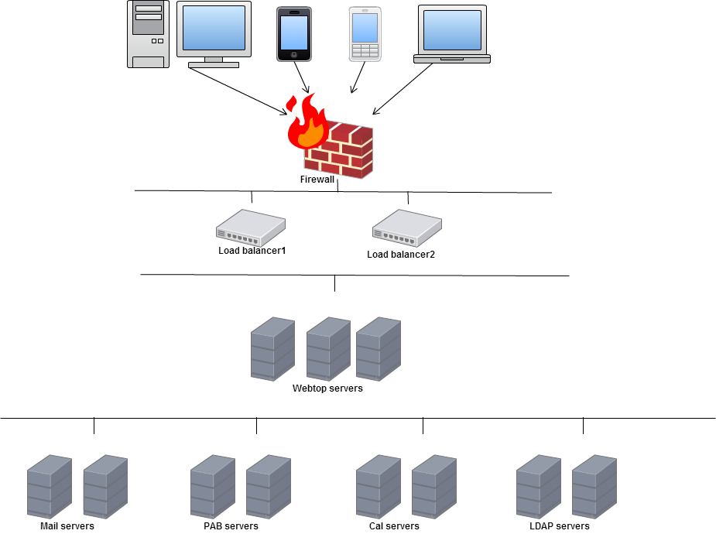
Simplified network architecture

Slide 3
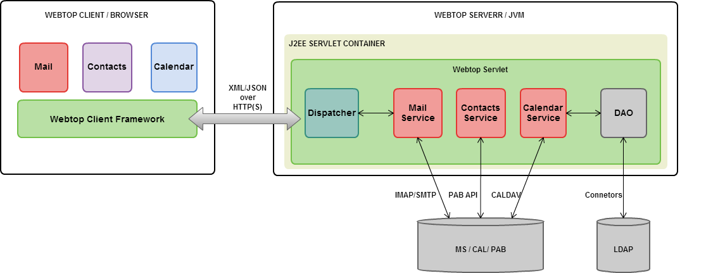
Logical components of Webtop

Slide 4
Integration with CP backend(Memova)
CPMS, PAB, CAL … publish themselves in locator PED on startup (PED name, host, ports, pwds, …)
All UPS (master or slaves), and all locators (master or slaves) also are declared in locator PED
Webtop only knows 1 locator detail (in webtop-conf.xml). It connects this locator on startup and load the locator and ups DSA details from the PED. From here they find the whole platform details.
Reading master or slave DSA is hidden in driven by servers / lib (ups, locator)
Connector is Methane.jar

Slide 5
Integration with CP backend(Memova)
webtop-conf.xml:
<ups principal="cn=manager" credentials="password" url="ldap://10.13.16.66:389/dc=cpchina,dc=locups,dc=net" />
<nplex principal="cn=manager" credentials="password" url="ldap://10.13.16.66:389" base="dc=cpchina,dc=nplex,dc=net" />

Slide 6
Integration with OW backend(Mx)
Webtop doesn’t connect to LDAP directly, it calls mOS API and access configuration server to fetch info
Locator = mOS + config.db
UPS = mOS
Connector is Octane.jar

Slide 7
Integration with OW backend(Mx)
webtop-conf.xml:
to set mOS server URL
<mxos url="http://rwc-hinoki05:8081/mxos" maxConnections="50" connectionTimeout="120s" readTimeout="60s" contextId="MXOS-REST-WEBTOP" />
System environment parameter:
to set configuration server URL
INTERMAIL=rme://rwc-hinoki05.owmessaging.com:5000

Slide 8
version.xml
It’s a servlet to track the version of Webtop components.
http://ruby.qa.laszlosystems.com:6020/cp/version.xml
Mercury: Webtop server SDK
Methane: Server Memova connector
Octane: Server Mx connector
Otosan: SoftBank connector, since softBank using Hitchi EMAS contact server
Peridot: Webtop client SDK
Melon: BT customized code, including server and client
Cheese: Swisscom customized code, including server and client
Kiwi/Kiwi-octane: RichUI 2.0 (fusion)

Slide 9
What is Fusion?
New messaging platform that combines components from OWM and CP platforms
OWM Platform
Email Mx
CP Platform
RichUI/TouchUI
Webtop
PAB
CAL

Slide 10
Email Mx
Components
MTA Server
IMAP Server
POP Server
Configuration Server
MSS Server
DirServer
mOS
Tools

Slide 11
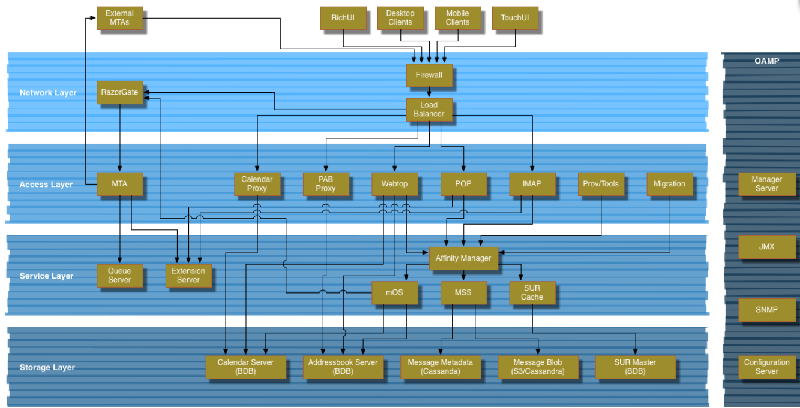
Fusion Deployment

Slide 12
Fusion Logic flow
CardDAV
PAB
CalDAV
CAL
POP
REST
Telnet
Rich UI
AUTH
WebTop
mOS
SendMail
RME
SMTP
MTA
AUTH
Notify
MSS
Touch UI
Notify
AUTH
LDAP
IMAP
IMAP
DIR
Config Server

Slide 13
mOS and PAB & CAL
Read settings
PAB
retrieve
LDAP
mOS
provision
CAL
Read settings

Slide 14
mOS and Webtop
LDAP
Webtop
mOS
MSS

Slide 15
Configuration
mOS
Webtop
PAB
Config Server
CAL
DIR
…

Slide 16
Connect to mOS
/*/common/mxOsServiceHost:
[notifyservice bjfusion1:8081]
[mailboxservice bjfusion1:8081]
[sendsmsservice bjfusion1:8081]
[sendmailservice bjfusion1:8081]
[default bjfusion1:8081]

Slide 17
Document
mOS online document
http://home.openwave.com/~devbuild/mxos/falcon/mxos-doc/
REST API
Webtop online document
http://rwc-hinoki06.owmessaging.com:8080/kiwi-octane/apidoc/
JSON RPC

Slide 18
Thank You

